Slide 1

MECHANICAL TOOLS

Slide 2
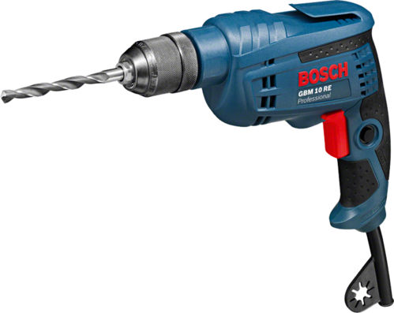
Electric Drill Machine
Bore holes in a hard material like a wall or wood.
Electrically operated
Directions can be controlled. (Clockwise-Anticlockwise)

Slide 3
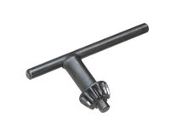
Chuck Wrench
Adjusts chuck
Tightening of chuck
Loosening of chuck

Slide 4
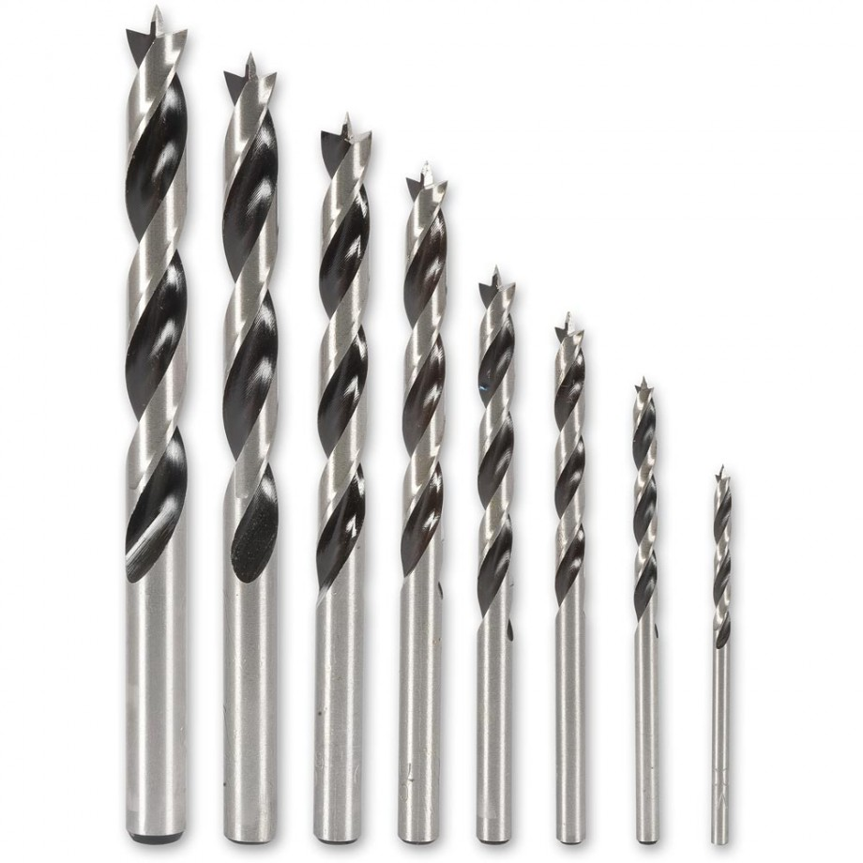
Drill Bits
It is a cutting tool.
It is used to remove material to create hole.
Generally circular in size.

Slide 5
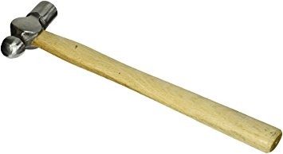
Ball Peen Hammer
Commonly used as a tool for metalworking.
Peening face is useful for rounding off edges.
Ball face is used to make mechanical seal for two mating surfaces

Slide 6
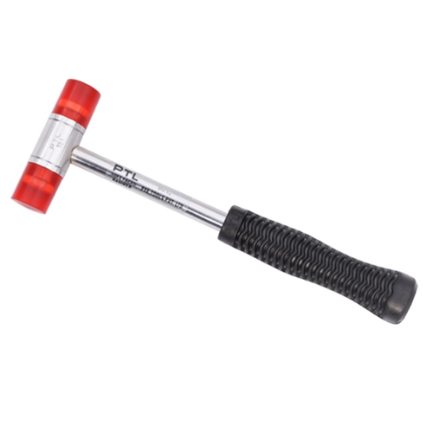
Mallet
A kind of hammer
Generally do not leave any dent in workpiece.

Slide 7
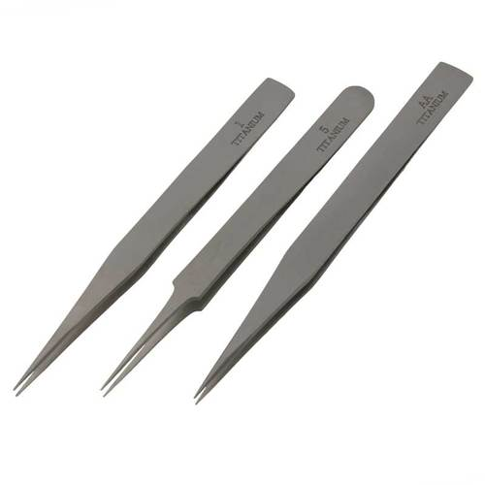
Tweezer
A class 3 lever.
Used to hold small objects.
We can use it for soldering of electrical components.

Slide 8
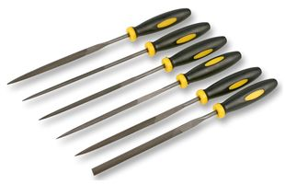
File Set
A hand tool.
It is used to remove fine amount of material from workpiece.
It is made up of case hardened steel.
Comes in various shapes.

Slide 9
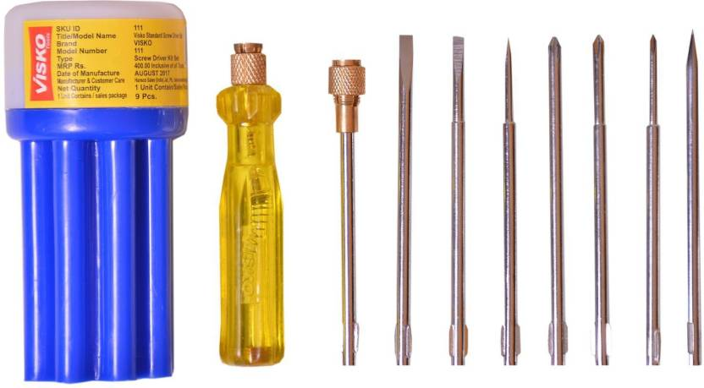
Screw Driver Set
It is a tool used to insert and/or remove screws.
It has two parts
Handle
Drive Tip

Slide 10
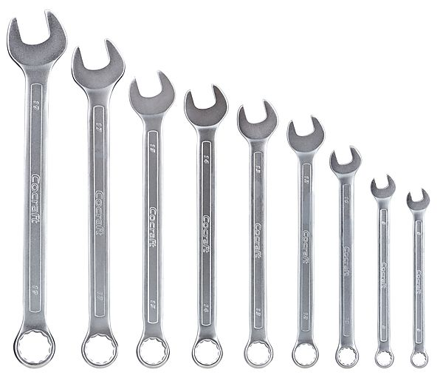
Open Ended Spanner
It is a tool that provides grip and mechanical advantage in applying torque/force to turn objects.
Mostly used for nuts and bolts.

Slide 11
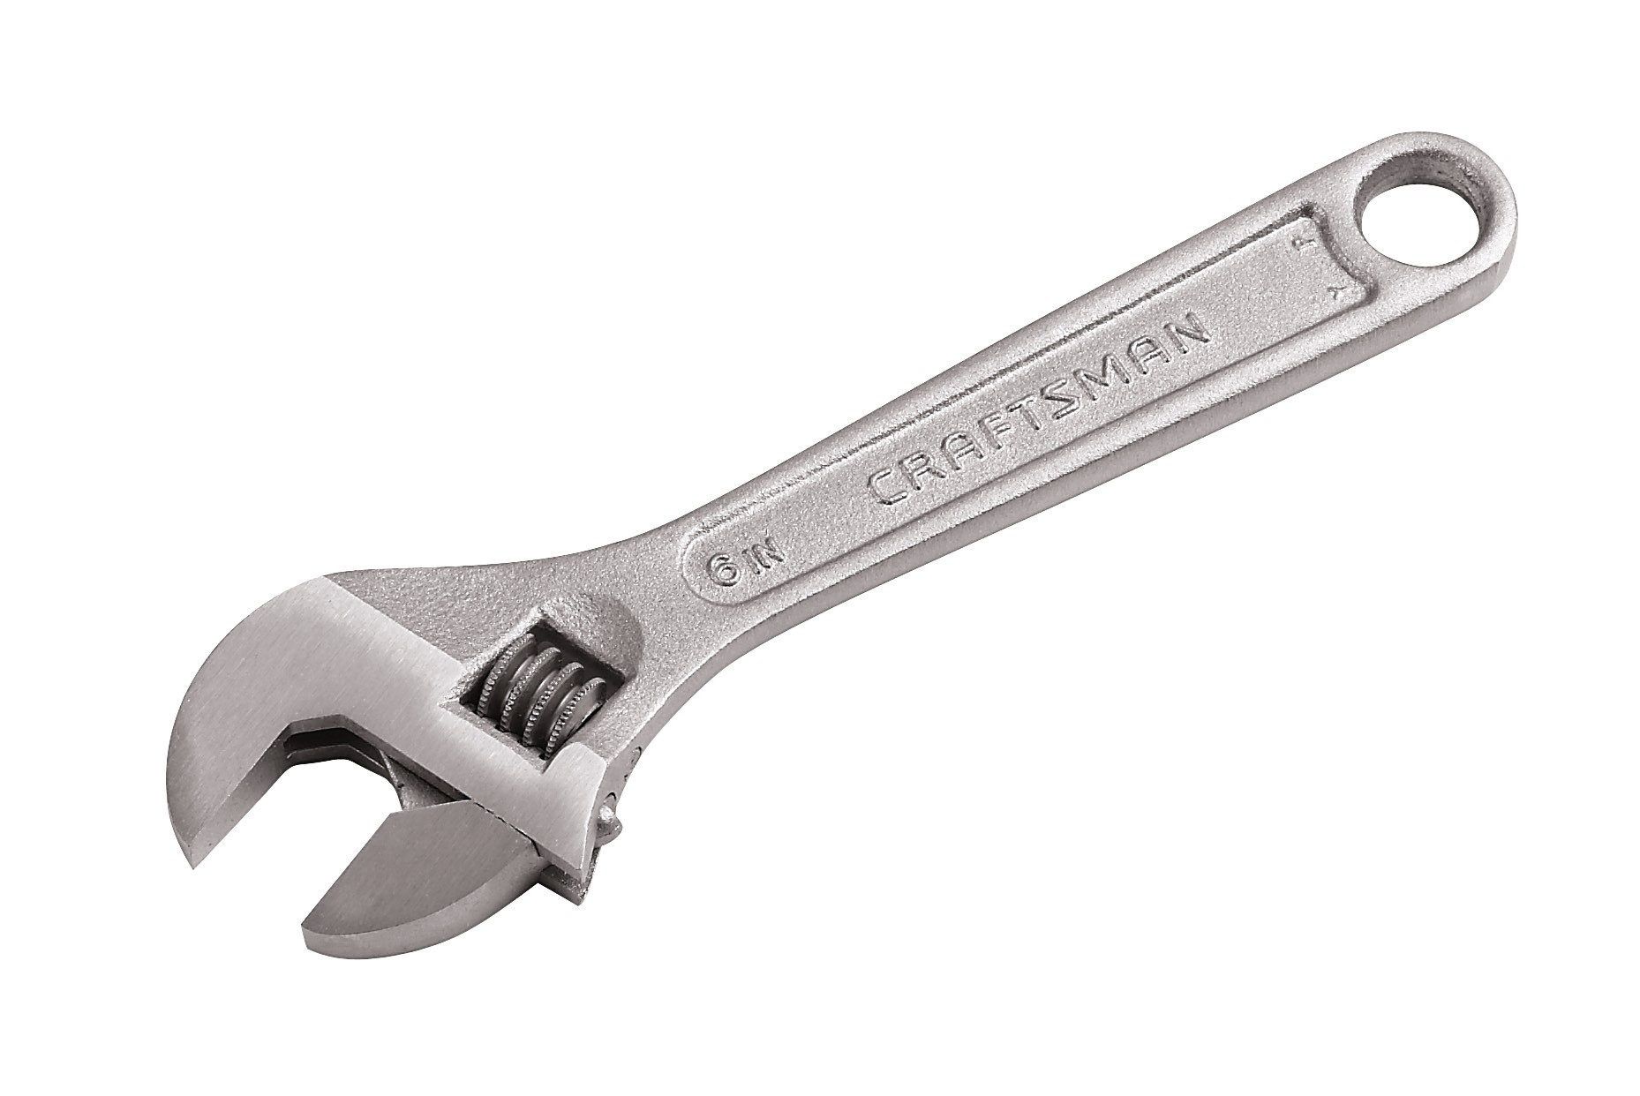
Adjustable Wrench
It has a movable jaw.
It allows us to use different sizes of fastener heads

Slide 12
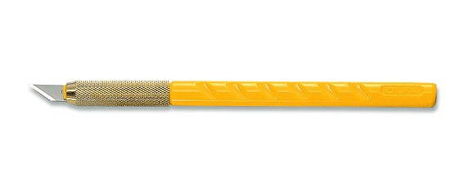
Art Cutter
It is a hobby knife.
It can be used for precision cutting.
Head rotates 360 Degrees to cut at any angle.
Suitable for craft.

Slide 13
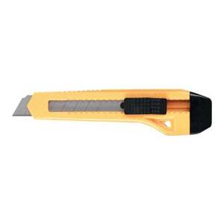
Heavy Duty 18mm Cutter
Very compact and lightweight.
It has retractable grip.
Ideal for thicker cuts.

Slide 14
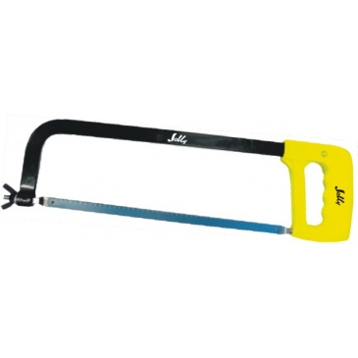
Hacksaw Blade with Frame
A fine toothed saw.
Mainly used for metal cutting.
It has a C-shaped frame that holds the blade

Slide 15
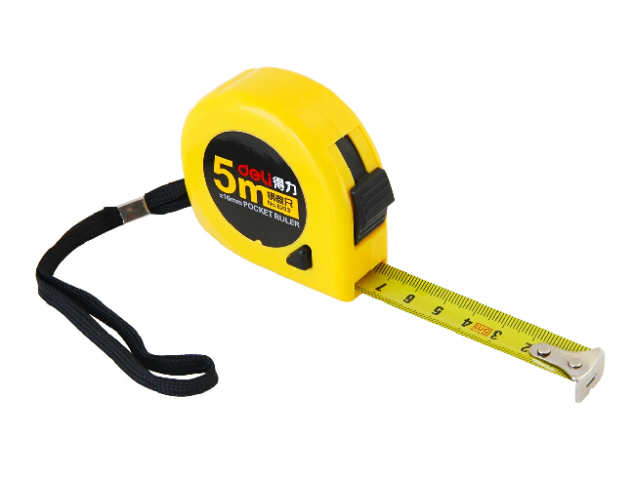
Measurement Tape
It is a flexible ruler.
Can measure centimeter, meter, inch, foot.

Slide 16
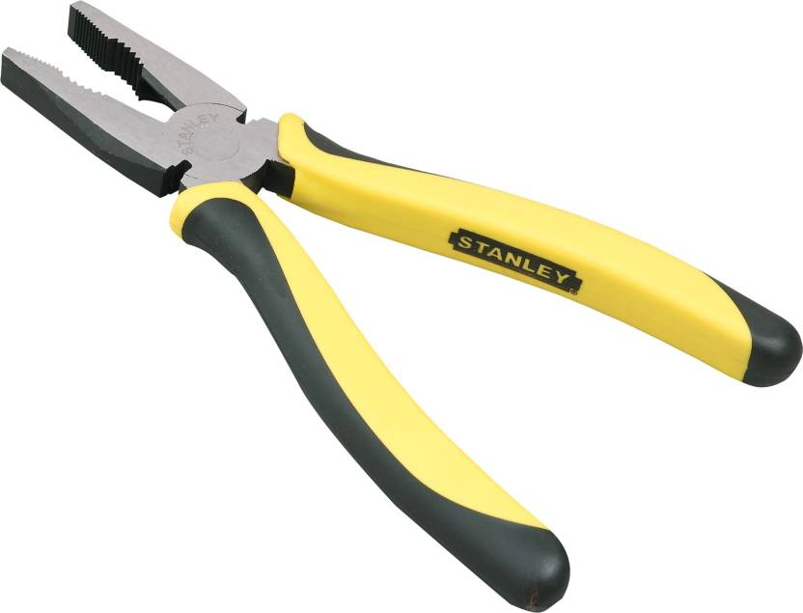
Plier
It is a hand tool.
It is used to hold objects firmly.
Also useful for bending and compressing a wide range of material.

Slide 17
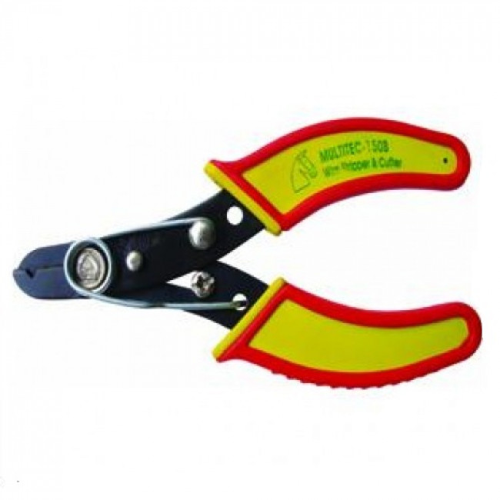
Wire Stripper
Small handheld device.
Used to strip/remove electrical insulation from electric wires.

Slide 18
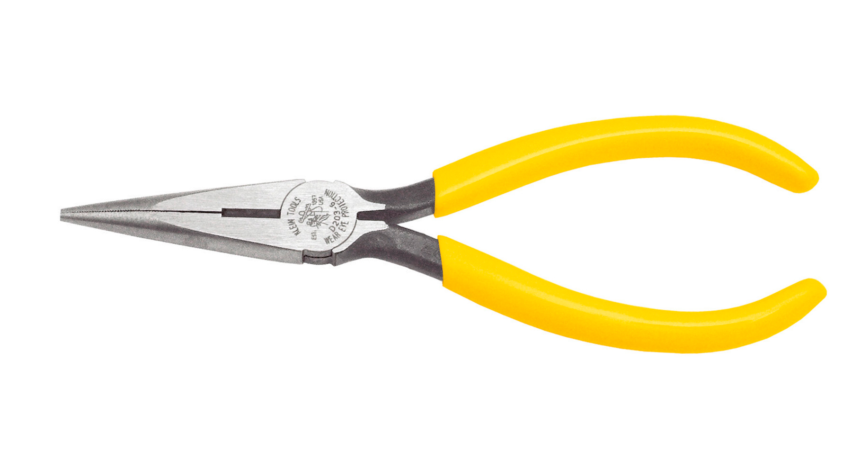
Needle Nose Plier
It is a cutting as well as holding plier.
Long nose gives excellent control in handling objects.
Also can be used to bend, re-position and snip wire.

Slide 19
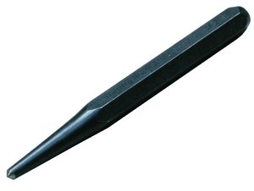
Center Punch
It is used to mark a center of a hole when drilling holes.
It is used with ball-peen hammer.

